Slide 1

CampusFlow: An Intelligent Campus Queue Management and Resource Allocation System
DSA0105A-OBJECT ORIENTED PROGRAMING WITH C++
Presented by
Cheerala Jyothi (192425312)
Anto Princy A (192411071)
S Dhana Sri (1925260062)
M.Sugiritha(192471020)
Guided by :JEGADEESH K

Slide 2


ABSTRACT
  CampusFlow is an intelligent system for managing campus queues and resources.
  Estimates student waiting times using queue and service data.
  Forecasts crowd congestion using historical demand patterns.
  Recommends suitable counters, staff, and available campus resources.
  Provides dashboards and analytics to support efficient campus operations.
1
2
Notes:
null

Slide 3
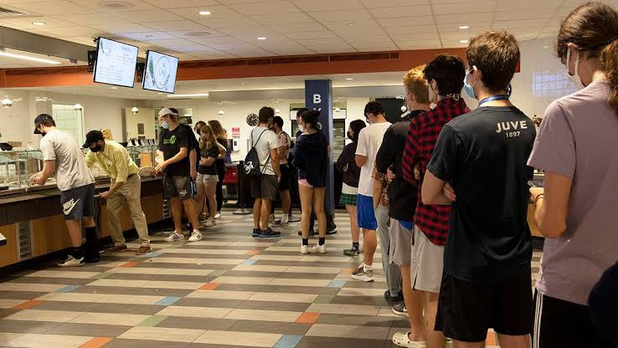
PROBLEM STATEMENT
  Students experience long queues at canteens and administrative offices.
  Lack of real-time information makes waiting times unpredictable.
  Uneven demand leads to overcrowded facilities and underutilized resources.
  Manual resource allocation makes it difficult to respond to changing demand.
  Existing basic token systems may not provide predictive analytics or resource recommendations.
1
2
Notes:
null

Slide 4
OBJECTIVE
  Develop a C++-based intelligent campus queue management system.
  Estimate waiting times and forecast future crowd congestion.
  Optimize the allocation of counters, staff, and campus resources.
  Provide real-time queue status and resource availability through a dashboard.
  Evaluate system efficiency using prediction accuracy and resource utilization metrics.
1
2
Notes:
null

Slide 5
PROPOSED SYSTEM
  Centralized platform for managing campus facilities, queues, and resources.
  Digital token generation with queue-position tracking.
  Waiting-time prediction using service duration and queue information.
  Intelligent recommendations based on demand, availability, and capacity.
  Analytics dashboard with congestion alerts and resource-allocation insights.
1
2
Notes:
null

Slide 6
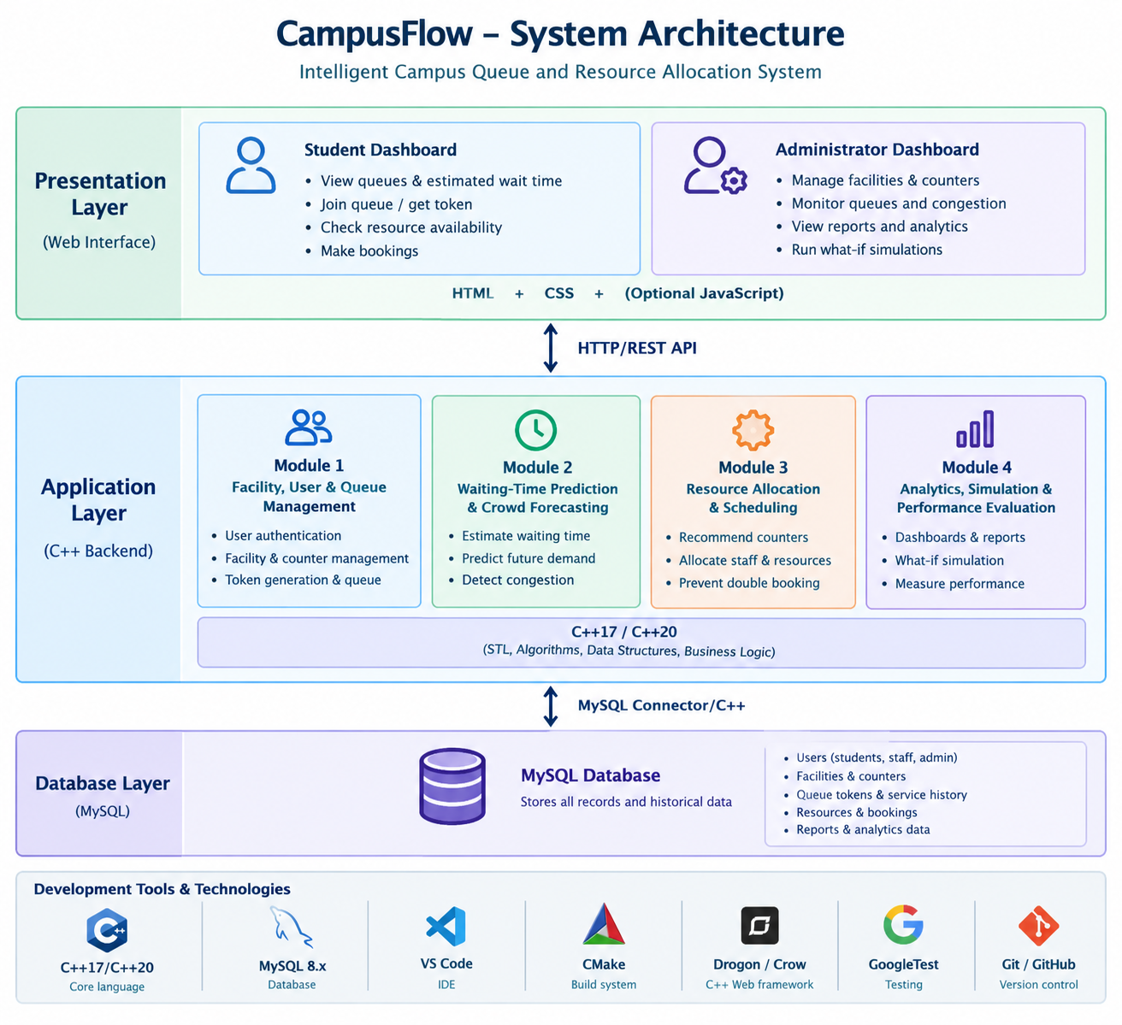
System Architecture Diagram
1
2
Notes:
null

Slide 7
Module 1: Campus Facility, User and Queue Management
  Manages student, staff, and administrator accounts.
  Registers campus facilities, counters, and resource capacities.
  Generates unique digital tokens for campus services.
  Maintains queue order and tracks service status.
  Stores user, facility, and queue records in MySQL.
Parameters: User roles, facility type, queue length, token ID, service status.
Outcome: Organized digital queues and centralized campus data management.
1
2
Notes:
null

Slide 8
Module 2: Waiting-Time Prediction and Crowd Forecasting
  Estimates waiting time using queue length and service duration.
  Calculates average service time from historical records.
  Forecasts future demand over 15-, 30-, and 60-minute intervals.
  Classifies congestion as Low, Moderate, High, or Critical.
  Explains predictions using current queue and historical demand data
Parameters: People waiting, service duration, active counters, historical arrivals.
Outcome: More predictable waiting times and early identification of congestion
1
2
Notes:
null

Slide 9
Module 3: Intelligent Resource Allocation and Scheduling
  Recommends less congested service counters.
  Allocates staff and counters according to expected demand.
  Tracks library seats, computers, and laboratory slots.
  Prevents double bookings and resource-capacity violations.
  Suggests alternative facilities or time slots when resources are unavailable.
Parameters: Resource capacity, availability, staff count, expected demand, waiting-time target.
Outcome: Better resource utilization and reduced avoidable waiting.
1
2
Notes:
null

Slide 10
Module 4: Campus Analytics, Simulation and Performance Evaluation
  Displays queue status, estimated waits, and resource availability.
  Generates historical facility and service reports.
  Simulates changes such as adding counters or increasing staff.
  Compares predicted waiting times with actual service results.
  Evaluates queue correctness, prediction accuracy, and resource utilization.
Parameters: Prediction error, average waiting time, utilization rate, response time.
Outcome: Data-driven campus management and measurable system performance.
1
2
Notes:
null

Slide 11
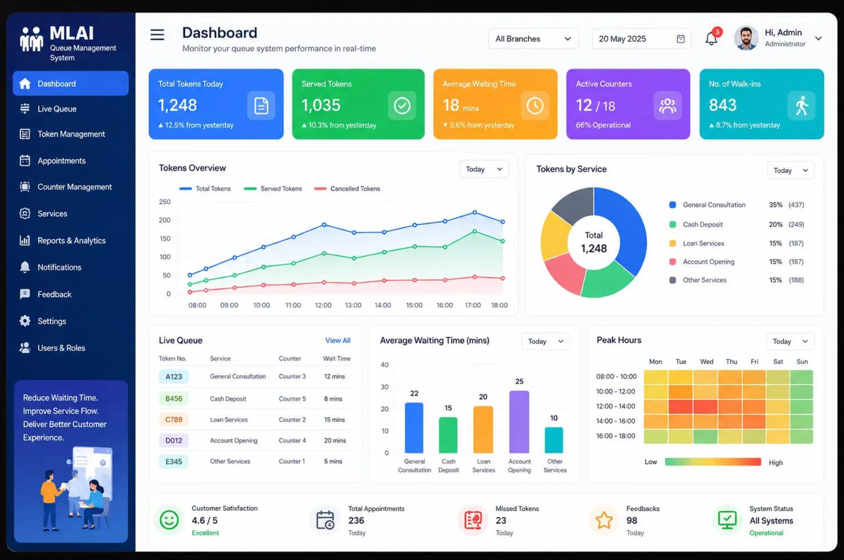
SAMPLE OUTPUT
1
2
Notes:
null

Slide 12
ADVANTAGES
  Reduces uncertainty about student waiting times.
  Helps identify peak hours before congestion becomes severe.
  Improves utilization of available staff and campus resources.
  Reduces manual queue management and scheduling effort.
  Supports transparent, data-driven campus decisions.
1
2
Notes:
null

Slide 13
CONCLUSION
  CampusFlow integrates queue management, prediction, and resource allocation.
  C++ algorithms support efficient queue processing and decision-making.
  Historical data enables demand forecasting and performance evaluation.
  The dashboard improves visibility into campus services and availability.
  The system has the potential to improve campus service efficiency through measurable, data-driven optimization.
1
2
Notes:
null

Slide 14
THANK YOU

